Slide 2
LET’S TRIVIA!
ON YOUR MARKS!
GET SET!

Slide 3
What are the five most commonly spoken languages in the world?
QUESTION 1

Slide 4
Which American soft drink was introduced in 1885?
QUESTION 2

Slide 5
QUESTION 3
As a bribe, what did the Queen offer Snow White?

Slide 6
NAME THIS SONG FROM THE 70s!
QUESTION 4

Slide 7
MULTIPLE CHOICE!
In which year was the first ever test-tube baby born?
1967
1972
1978
1983
QUESTION 5

Slide 8
WHAT AM I?
My name is derived from a Spanish word which refers to the grin of a monkey or a grotesque face. To medieval travellers, such as Marco Polo, I was known as the Nux Indica. I am an invaluable crop for many tropical countries. My oil is used extensively in the food industry, soap manufacture and cosmetics. Sugar is made from the nectar of my flower and sap. What am I?
QUESTION 6

Slide 9
QUESTION 7
Which is further East—
Hawaii OR Tahiti?

Slide 10
QUESTION 8
WHO HAD THIS MOVIE HIT!
Bonus: Name the movie!

Slide 11
MEASUREMENTS FOR THREE POINTS!
What do these instruments specifically measure?
Barometer
Chronometer
Spectrometer
QUESTION 9

Slide 12
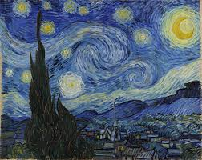
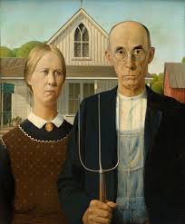
QUESTION 10
PIC-A-PIC

Slide 13
SPOT QUESTION!
How much horsepower does a 2014 Dodge Viper SRT have in its engine?

Slide 14
QUESTION 11
In BC, the top 8 popular types of fish are caught both in fresh and salt water. Name any four of the eight most popular!

Slide 15
TIME FOR AN ANAGRAM!
The words:
THAT GREAT CHARMER
are an anagram of
which famous politician?
QUESTION 12

Slide 16
FIVE CLUES – WHAT AM I?
I am man-made
Sometimes I have a yard
You might find me in school
I’m longer than I am wide
I might be made of metal
QUESTION 13

Slide 17
QUESTION 14
WHO HAD THE 50s HIT

Slide 18
With which sport do you
associate the following people:
Frenchman Jean Van der Velde
Englishman Eddie “the Eagle” Edwards
French Canadian Guy Lafleur
QUESTION 15

Slide 20
VIDEO QUESTION #1!
What is the name of the main actress in the movie?
How do they snort the “ecstasy”?
What colour are the wigs of the “working girls”?
QUESTION 16

Slide 21
QUESTION 17
What are the capital cities of:
El Salvador
Nicaragua
Panama
Newfoundland (& Labrador)

Slide 22
QUESTION 18
WHO HAD THIS 80s HIT!

Slide 23
QUESTION 19
Which James Bond character was played
by actor Richard Kiel on two occasions?

Slide 24
QUESTION 20
PIC-A-PIC

Slide 25
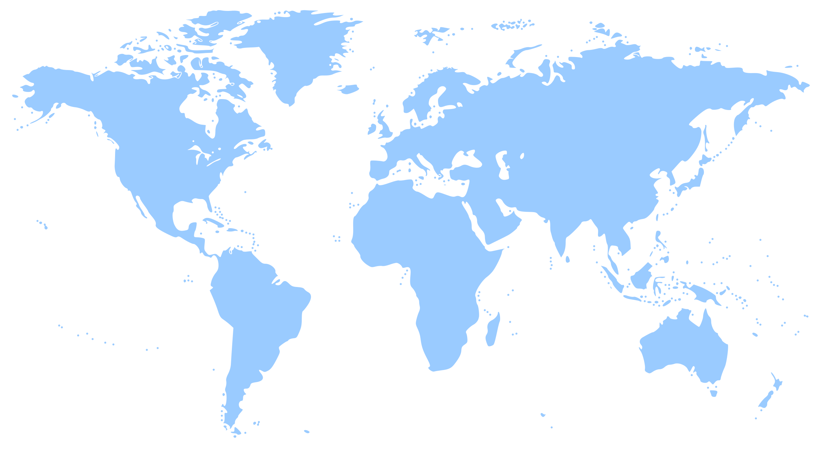
SPOT QUESTION!
Which Middle Eastern country gained
its independence from
Great Britain
in October 1932?

Slide 26
HALF TIME!

Slide 27
A DAWSON’S CREEK THREE-POINTER!
Who played Dawson Leery?
What was the character name of his best female friend?
In which town OR state was the show set?
QUESTION 21

Slide 28
What is the term used for when a motorcycle gang member leaves a club to join another?
QUESTION 22

Slide 29
NAME THIS SONG FROM THE 90s!
QUESTION 23

Slide 30
Mt. Vesuvius was situated near
which well-known ancient city?
Bonus: Which modern city is it now near?
QUESTION 24

Slide 31
QUESTION 25
Who is the American wife of retired Hockey Great Wayne Gretzky?

Slide 32
QUESTION 26
ORGANIZED CRIME FOR TWO POINTS!
What are the Japanese & Hong Kong
equivalents to the Mafia?

Slide 33
QUESTION 27
NAME THIS INSTRUMENTAL!

Slide 34
What German name was given to the
huge airships of the 1920s and 30s?
QUESTION 28

Slide 35
QUESTION 29
On which island did the Thunderbirds live?
Bonus point: What was the name of their organization?

Slide 36
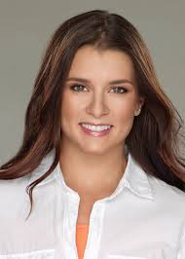
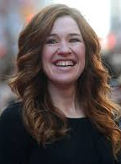
QUESTION 30
PIC-A-PIC

Slide 37
SPOT QUESTION!
VH1 ranked this singer #10 on their list of the 100 Greatest Women in Music. Who is it?

Slide 38
THIS WEEK’S ONLINE QUESTION!
QUESTION 31

Slide 39
How many years did Nelson Mandela
spend in prison?
QUESTION 32

Slide 40
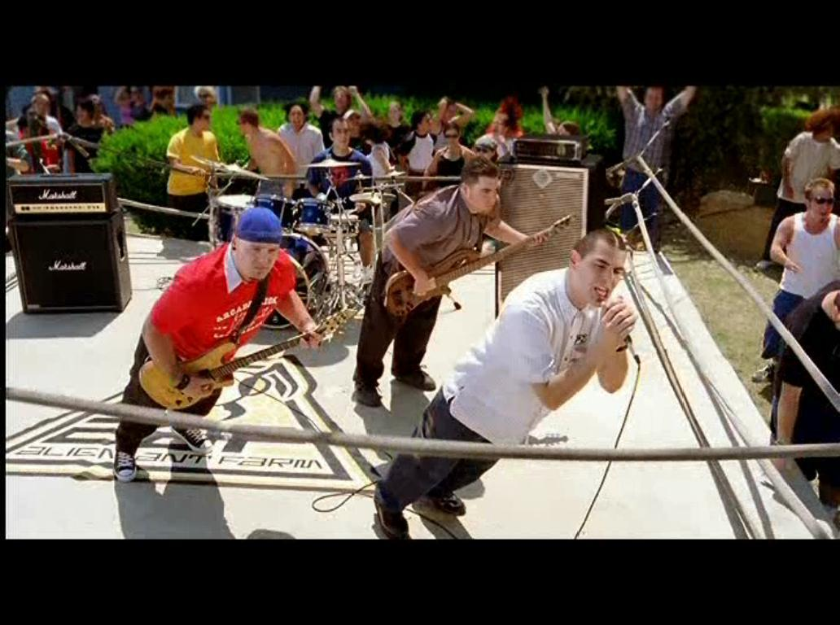
QUESTION 33
WHO HAD THIS 2006 HIT!

Slide 41
If a bee lives in a hive,
where do the following live?
A beaver
A wolf
A rabbit
QUESTION 34

Slide 43
VIDEO QUESTION #2
a. What floor does the elevator stop at? b. What is in the vault? c. What are they dealing?
QUESTION 35

Slide 44
QUESTION 36
In the TV series Heroes, what
are the character first names of:
The high school girl who heals instantly
The Japanese time traveler
The older of the two Petrelli brothers

Slide 45
QUESTION 37
PICK THE YEAR TRIPLE PLAY!

Slide 46
QUESTION 38
Who wrote Where the Wild Things Are?

Slide 47
What is the name of the westernmost point of mainland Great Britain?
QUESTION 39

Slide 48
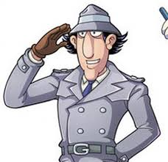
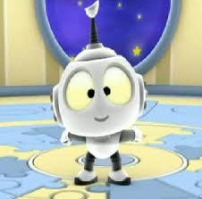
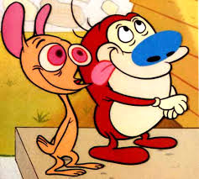
QUESTION 40
PIC-A-PIC

